Slide 1

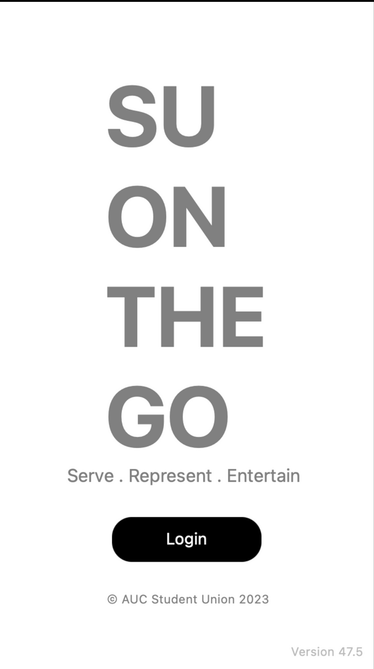
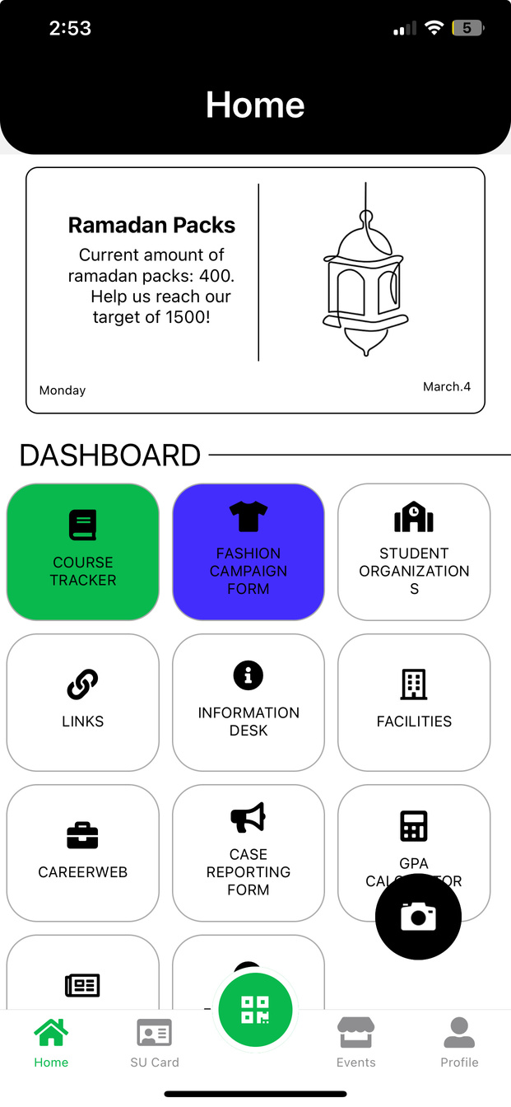



Market
to
go

Slide 2
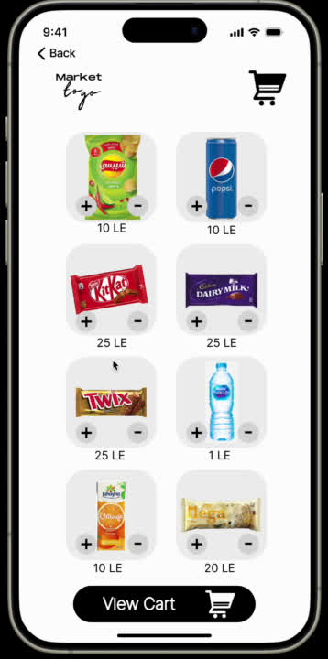

Slide 3
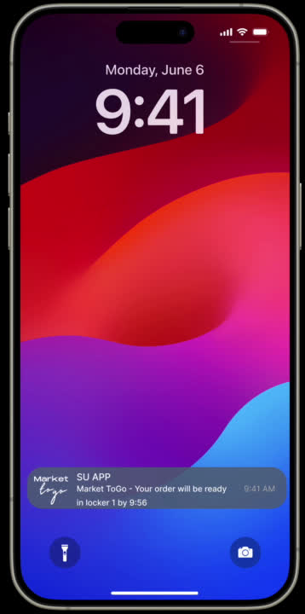

Slide 4
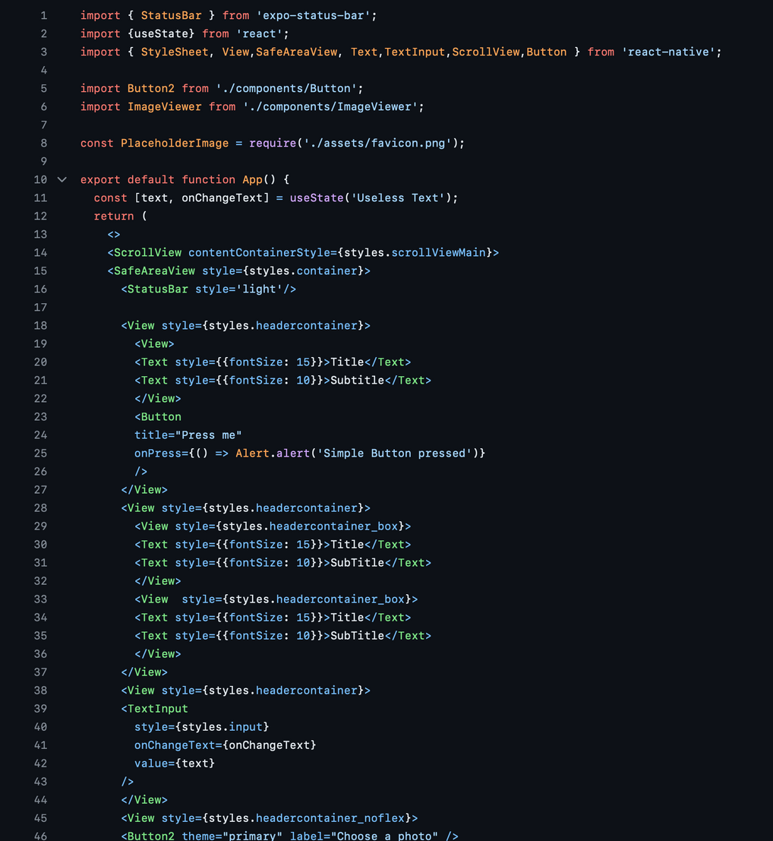
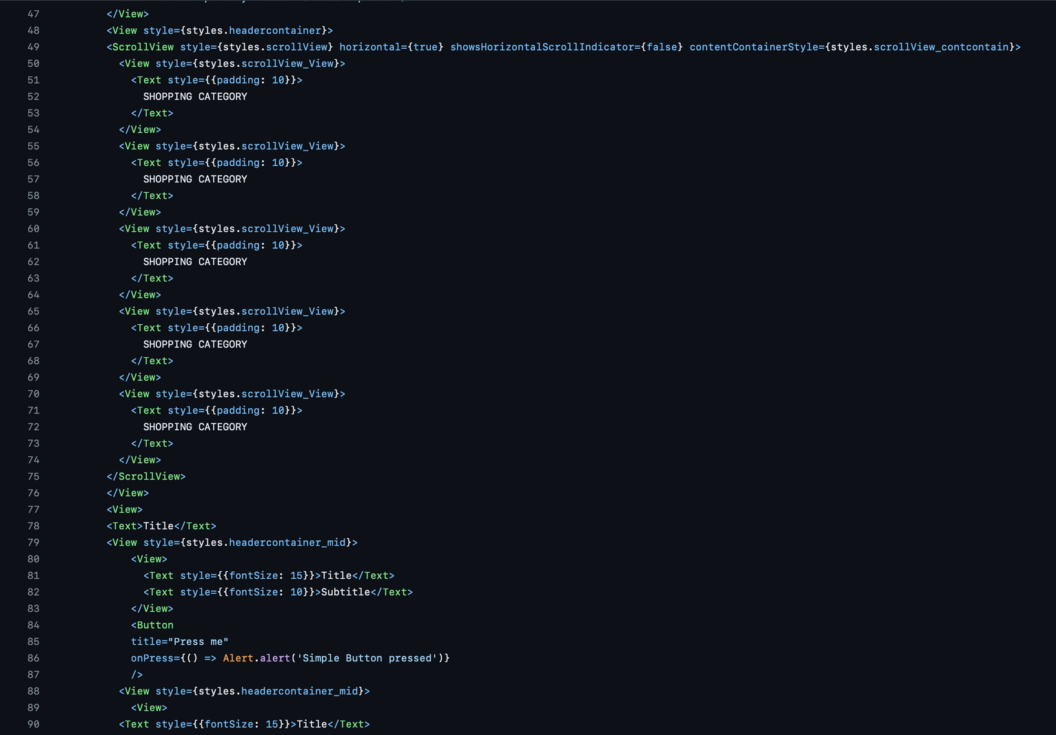

Slide 5
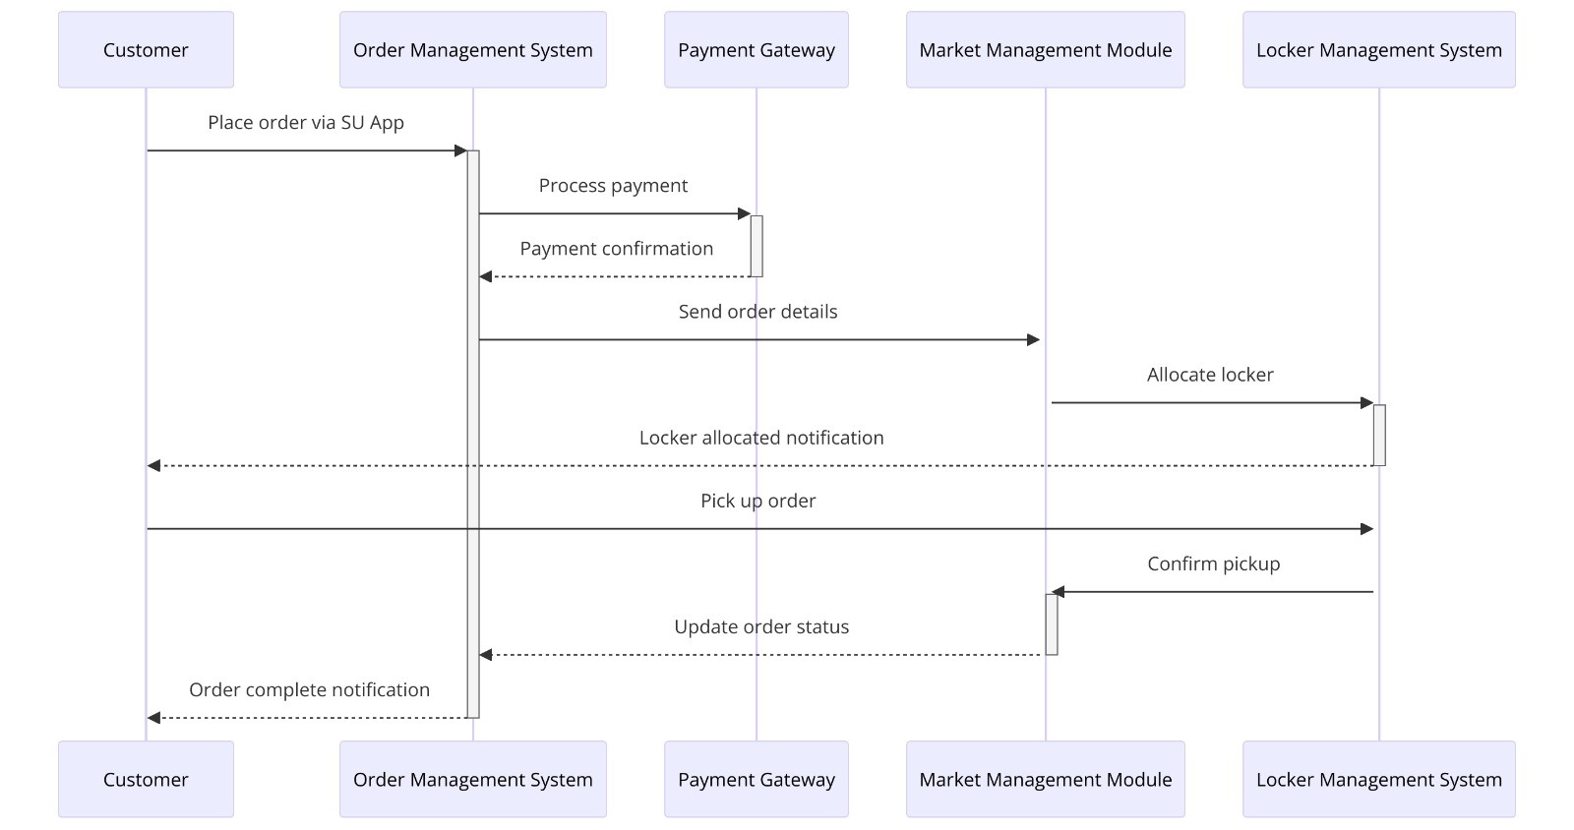

Slide 6
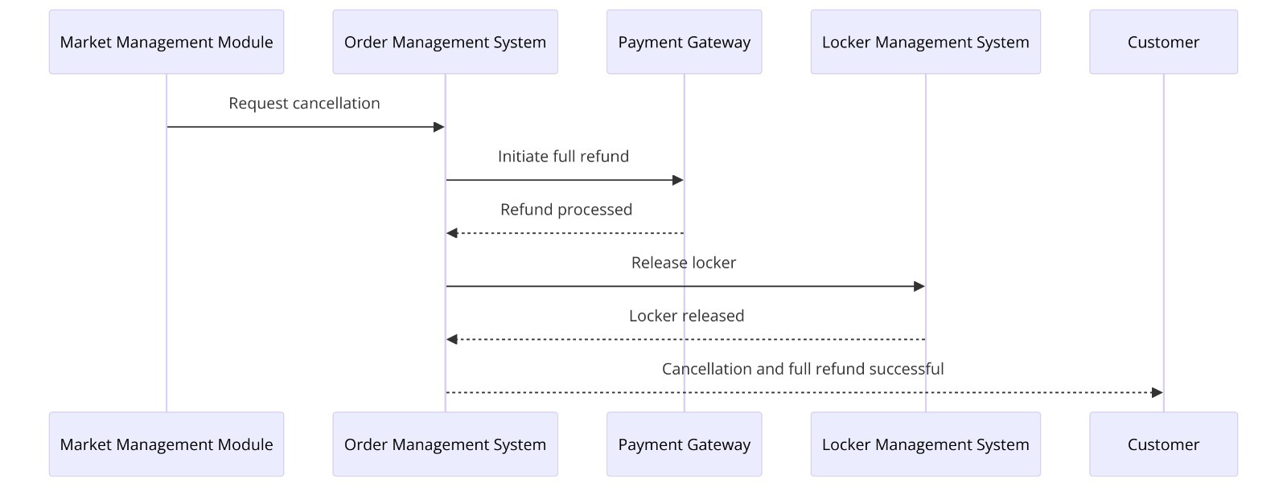

Slide 7
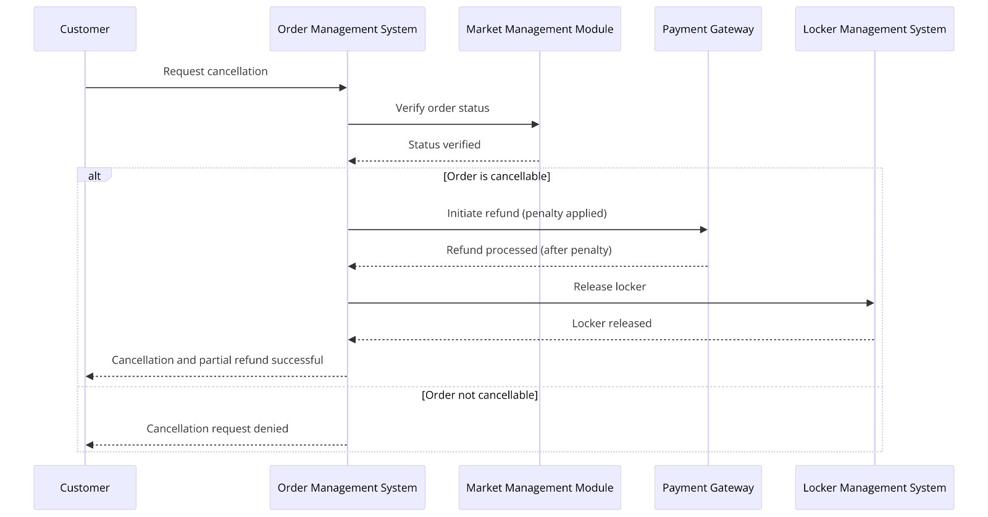

Slide 8
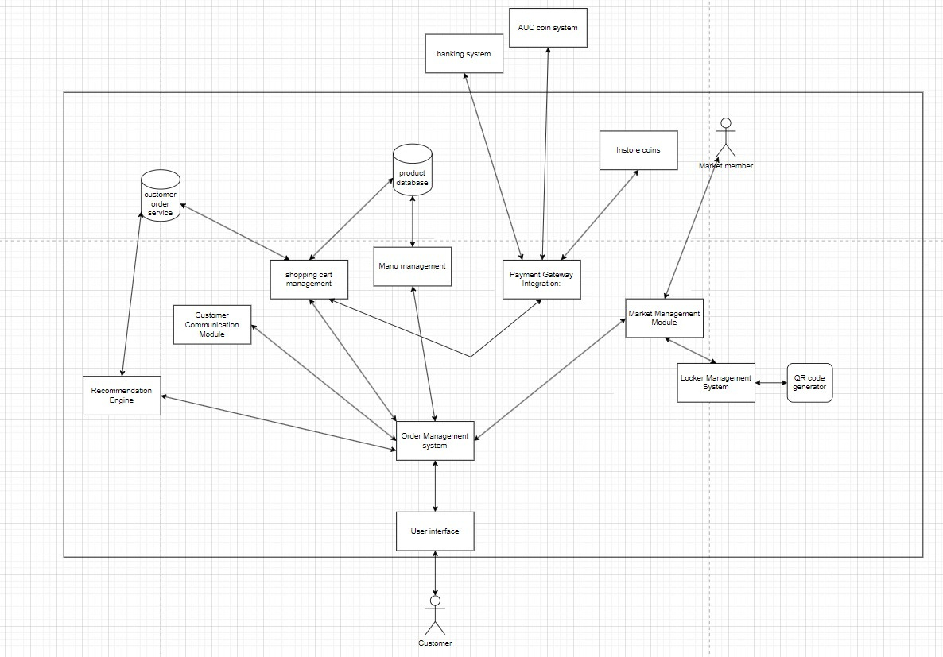

Slide 9

Functional Requirements:
Order from SU App
Customers should be able to place orders online through the system.
The system must facilitate secure online payments.
Customers should receive a confirmation email or notification upon successful order placement and payment.
Menu with items categorized with prices
The system should provide a menu of items available for ordering.
Each item should display its price.
Cart actions
Customers should be able to add, delete, and adjust quantities of items in their shopping cart before checkout.
Quantity display, (reflected either from the PO system or manually)
The system should track inventory levels in real time.
Inventory updates should reflect immediately after each successful order placement.

Slide 10

Functional Requirements:
Option to pay either AUC account or voucher or Visa cash or in-store points
Customers should have multiple payment options which are Card, account credits, vouchers, cash, or loyalty points.
Adding comments
Customers should be able to add comments or special instructions to their orders.
The market managers can stop taking orders during busy times
The system should allow market managers to pause order taking during peak hours or when the store is busy.
Choice of pickup time
Customers should be able to choose a preferred pickup time for their orders.
Option to cancel order, no refunds
Customers should be able to cancel orders, but refunds may not be provided depending on the cancellation policy.

Slide 11
Functional Requirements:
Order sent to system
Upon order confirmation, the system should notify the market managers and send them the details of the order.
The system can send confirmation, cancel, or recommend other options
The system should be able to confirm orders once received from the Customers.
Upon confirmation, Customers should receive a notification or confirmation email acknowledging their order.
The market managers along with the system should have the capability to cancel orders if necessary, such as due to unavailability of items, unforeseen circumstances, or at the request of the Customers.
Customers should be notified promptly if their order is canceled, and any payments made should be refunded as per the cancellation policy.
If certain items in the customer's order are unavailable, the system should be able to recommend alternative options to the Customers.
These recommendations could be based on similar items available in stock, special offers, or substitutions suggested by the system.
Customers should be notified of these recommendations along with the option to accept or decline them before finalizing their order.

Slide 12
Functional Requirements:
Estimated pick-up time
The system should provide customers with an estimated pickup time for their orders.
The system allocates locker
Upon order confirmation, the system should reserve a locker for the customer and associate it with their order.
Keep track of late pick-ups and cancel automatically
If an order is not picked up within a specified time frame, the system should automatically release the locker, cancel the order, and notify the customer.
Create a Bluetooth connection to open the locker from the app
Customers should be able to access the locker by scanning a wireless signal generated by the app.

Slide 13
Functional Requirements:
Show past orders
Customers should have access to their order history, showing past orders placed through the system.
Give recommendations on what items to get
The system should provide personalized recommendations based on past orders or customer preferences.
Get push notifications
Customers should receive timely notifications via email or SMS regarding order status, locker access, and pickup reminders, including notifications for items ordered regularly.

Slide 14

Nonfunctional Requirements:
Performance:
The system should handle up to 200 customers at a time without significant performance degradation.
Response times for order placement, locker reservation, and Bluetooth should not exceed 2 seconds through load balancing the orders.
Security:
Secure encryption protocols should be implemented to safeguard user payment information.
Measure the strength of encryption and compliance with industry standards.
Access to lockers with Bluetooth through phone to provide authentication to prevent unauthorized access.
Utilize AES-256 encryption for all payment data transmission and storage, complying with PCI-DSS standards.

Slide 15
Nonfunctional Requirements:
Reliability:
The system should minimize downtime and service interruptions.
Achieve a minimum of 99.9% uptime over a monthly period.
Perform full backups of the system data at least once daily.
Conduct full backups of system data once every 24 hours.
Achieve a lean time to failure (LTT) of at least 30 days and a mean time between failures (MTBF) of at least 90 days for the payment processing system.
Reduce the recovery time objective (RTO) for payment system failures to less than 4 hours.
Scalability:
The system architecture should be scalable to accommodate future growth in user base and order volume.
Achieve a minimum of 20% increase in system capacity to accommodate future growth.
Load balancing mechanisms should be in place to distribute traffic evenly across servers.
maintain server utilization below 70% during peak loads.

Slide 16
Nonfunctional Requirements:
Usability:
The user interface should be intuitive and user-friendly, catering to users of varying technical expertise.
Achieve a minimum System Usability Scale (SUS) score of 75 out of 100.
Clear instructions should be provided for order placement, QR code scanning, and locker access.
Achieve a minimum task success rate of 90% for order placement, QR code scanning, and locker access.
Accessibility:
The system should be accessible to users with disabilities, complying with relevant accessibility standards. (Web Content Accessibility Guidelines (WCAG)).
Regulatory Compliance:
The system should adhere to relevant data protection regulations such as GDPR or CCPA.(95% compliance)
Payment processing should comply with PCI DSS standards to ensure secure transactions.
Money transactions with the AUC application, SU coin, and banking system
The money transactions should use AUC coin / adhere to the banner payments/bank transactions / SU coins
Achieve 100% adherence to Banner payment guidelines and banking regulations.

Slide 17
Nonfunctional Requirements:
Performance:
The system should handle up to 200 customers at a time without significant performance degradation.
Response times for order placement, locker reservation, and Bluetooth should not exceed 2 seconds through load balancing the orders.
Security:
Secure encryption protocols should be implemented to safeguard user payment information.
Measure the strength of encryption and compliance with industry standards.
Access to lockers with Bluetooth through phone to provide authentication to prevent unauthorized access.
Utilize AES-256 encryption for all payment data transmission and storage, complying with PCI-DSS standards.

Slide 18
Nonfunctional Requirements:
Reliability:
The system should minimize downtime and service interruptions.
Achieve a minimum of 99.9% uptime over a monthly period.
Perform full backups of the system data at least once daily.
Conduct full backups of system data once every 24 hours.
Achieve a lean time to failure (LTT) of at least 30 days and a mean time between failures (MTBF) of at least 90 days for the payment processing system.
Reduce the recovery time objective (RTO) for payment system failures to less than 4 hours.
Scalability:
The system architecture should be scalable to accommodate future growth in user base and order volume.
Achieve a minimum of 20% increase in system capacity to accommodate future growth.
Load balancing mechanisms should be in place to distribute traffic evenly across servers.
maintain server utilization below 70% during peak loads.

Slide 19
Nonfunctional Requirements:
Usability:
The user interface should be intuitive and user-friendly, catering to users of varying technical expertise.
Achieve a minimum System Usability Scale (SUS) score of 75 out of 100.
Clear instructions should be provided for order placement, QR code scanning, and locker access.
Achieve a minimum task success rate of 90% for order placement, QR code scanning, and locker access.
Accessibility:
The system should be accessible to users with disabilities, complying with relevant accessibility standards. (Web Content Accessibility Guidelines (WCAG)).
Regulatory Compliance:
The system should adhere to relevant data protection regulations such as GDPR or CCPA.(95% compliance)
Payment processing should comply with PCI DSS standards to ensure secure transactions.
Money transactions with the AUC application, SU coin, and banking system
The money transactions should use AUC coin / adhere to the banner payments/bank transactions / SU coins
Achieve 100% adherence to Banner payment guidelines and banking regulations.

Slide 20
Sprint Plan: Su to Go App Development
Duration: 2 weeks
Goals:
Set up project management on Jira.
Fix requirements for Su to Go app.
Design application screens on Figma.
Update the architecture to accommodate new requirements and ensure scalability.
Create sequence diagrams to visualize app functionality.
Analyze technology stack of original SU app.
Learn React Native for app development.
Develop UI of the application.
Begin testing the application.
Week 1:

Slide 21
Day 1: Jira Setup
Create the project on Jira.
Define Epics and user stories based on initial requirements.
Assign tasks to team members and set priorities.
Quote: "The key to success is to start before you're ready." - Marie Forleo
Day 2-3: Requirement Fixing
Review existing requirements.
Identify gaps and ambiguities.
Collaborate with stakeholders to clarify and update requirements.
Quote: "The beginning is the most important part of the work." - Plato
Day 4-5: Figma Design
Create mockups and wireframes of the application screens on Figma.
Iterate based on feedback from stakeholders and team members.
Finalize the design for implementation.
Quote: "Design is not just what it looks like and feels like. Design is how it works." - Steve Jobs
Day 6-7: Architecture Update
Evaluate current architecture.
Determine necessary changes based on updated requirements.
Update architecture documentation.
Quote: "Architecture is the learned game, correct and magnificent, of forms assembled in the light." - Le Corbusier

Slide 22
Week 2:
Day 8-9: Sequence Diagram Creation and Technology Stack Analysis
Map out the sequence of actions in the app.
Visualize user interactions with the system.
Analyze the technology stack used in the original SU app.
Quote: "A picture is worth a thousand words." - Fred R. Barnard
Day 10-11: React Native Learning
Begin learning React Native through tutorials and documentation.
Experiment with simple app components to understand its workflow and structure.
Quote: "The only source of knowledge is experience." - Albert Einstein
Day 12-13: UI Development
Translate updated requirements and sequence diagrams into UI components.
Focus on usability and aesthetics.
Ensure responsiveness for different devices.
Quote: "Design is not just what it looks like and feels like. Design is how it works." - Steve Jobs
Day 14: Initial Testing
Begin testing the application for basic functionality and UI/UX.
Identify and address any major issues or bugs.

Slide 23
Sprint Testing Log: Week 2
Objective: To conduct comprehensive UI testing for the "Su to Go" app, focusing on cross-device compatibility and A/B testing.
Testing Approach:
Leveraging the robustness of the existing SU server, our primary focus for this sprint has been on refining the UI to ensure an exceptional user experience.
We have implemented cross-device testing to ensure the UI functions seamlessly across different platforms and screen sizes.
Additionally, we have initiated A/B testing to evaluate various UI design iterations and determine the most effective approach.
Test Execution:
Cross-Device Testing:
iOS Testing: Developer A conducted thorough testing of the UI on iOS devices, ensuring consistency and functionality across different iPhone and iPad models.
Android Testing: Developer B performed rigorous testing of the UI on Android devices, ensuring compatibility with various screen resolutions and device configurations.
A/B Testing:
We created multiple versions of the UI with different design elements and layouts.
Team members tested these variations during the development process, providing valuable feedback on usability and intuitiveness.
Test Results:
Cross-Device Testing: The UI performed well on both iOS and Android devices,but still needs work on the aesthetics and look of the application.
A/B Testing: Initial feedback from team members highlighted preferences for certain UI elements, however some elements were not functional and toggling between different pages presented some issues.
What next ?
Implement minor UI adjustments based on feedback from cross-device testing to enhance usability across all platforms.
Finalize the UI design based on the preferred variations identified through A/B testing (making the add-to-cart easier without requiring a details page).

Slide 24
Sprint Retrospective: Sprint 1
What Went Well:
Figma Design:
The design phase on Figma proceeded smoothly. We successfully created mockups and wireframes for the application screens, incorporating feedback from stakeholders and team members.
Architecture Alignment:
We believe that our architecture is now on par with that of the SU app we aim to integrate with. This alignment sets a strong foundation for future development and integration efforts.
Requirements Fulfillment:
Overall, we managed to meet the targeted requirements set for this sprint. This ensures that we are progressing in the right direction towards our project goals.
What Could Have Gone Better:
UI Development Challenges:
The UI development took longer than anticipated, primarily due to the team's lack of experience. We encountered several errors and hurdles along the way, leading to delays in the implementation of UI components.
Testing Difficulties: Testing proved to be challenging since the application is still in its early stages. As a result, we had to rely on dummy data, which may not accurately represent real-world scenarios. This limitation hindered our ability to thoroughly assess the application's functionality and user experience.
Action Items for Improvement:
UI Skill Enhancement: To address the challenges faced during UI development, team members will dedicate time to enhancing their UI development skills. This may involve additional training, workshops, or pairing sessions with more experienced colleagues.
Exploratory Testing Focus: Given the limitations of testing with dummy data, we will focus on conducting more exploratory testing in the upcoming sprint. This approach will allow us to uncover potential issues and gather valuable insights into the application's behavior.
Continuous Learning: We will encourage a culture of continuous learning within the team, where members are encouraged to share knowledge, learn from each other's experiences, and stay updated on best practices in app development and testing.

Slide 25
What Could Have Gone Better:
UI Development Challenges:
The UI development took longer than anticipated, primarily due to the team's lack of experience. We encountered several errors and hurdles along the way, leading to delays in the implementation of UI components.
Testing Difficulties:
Testing proved to be challenging since the application is still in its early stages. As a result, we had to rely on dummy data, which may not accurately represent real-world scenarios. This limitation hindered our ability to thoroughly assess the application's functionality and user experience.
Action Items for Improvement:
UI Skill Enhancement:
To address the challenges faced during UI development, team members will dedicate time to enhancing their UI development skills. This may involve additional training, workshops, or pairing sessions with more experienced colleagues.
Exploratory Testing Focus:
Given the limitations of testing with dummy data, we will focus on conducting more exploratory testing in the upcoming sprint. This approach will allow us to uncover potential issues and gather valuable insights into the application's behavior.
Continuous Learning:
We will encourage a culture of continuous learning within the team, where members are encouraged to share knowledge, learn from each other's experiences, and stay updated on best practices in app development and testing.

